Slide 1
How to do FTP
With 『My Document』 as the interface to transport webpages from your computer to server

Slide 2
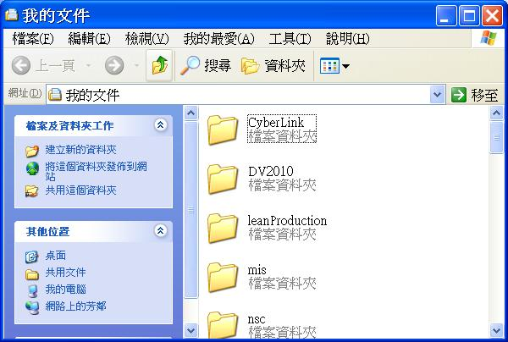
STEP 1:
Open Windows Explorer – 『My Document』 as the interface to transport webpages from your computer to server - ftp

Slide 3
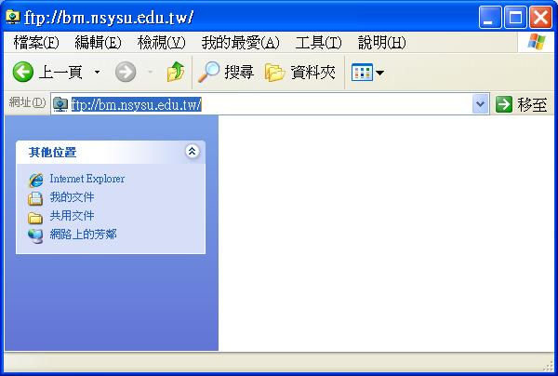
STEP 2:
In address box, enter ftp://bm.nsysu.edu.tw
A dialogue box will pop, just click "OK."

Slide 4
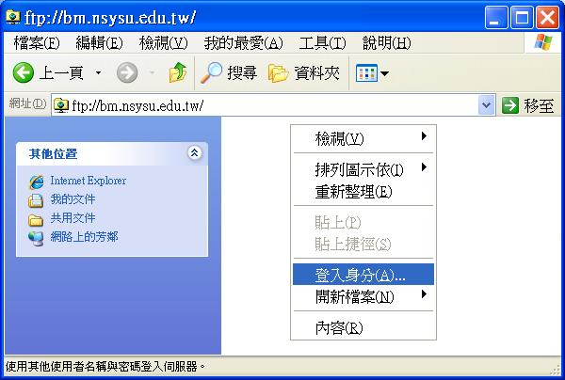
Right click in that opened window -- click 『login as (A)...』

Slide 5
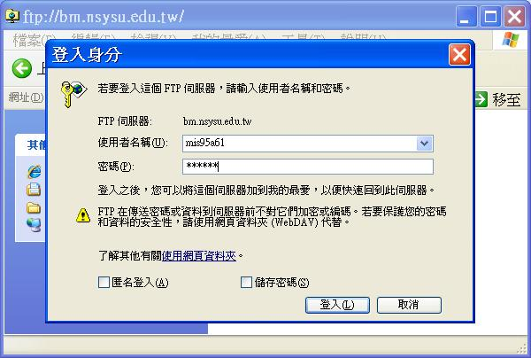
STEP 3:
a "login" dialog box will pop
Just Do It, enter your "username" and "password"
At a public computer, someone's username might
show. simply delete that and enter your own.

Slide 6
STEP 4:
Use your general knowledge about windows.
Cut and Paste, of course.
Cut and Paste

Slide 7
Username and Password
Usernames for Virtual Stores
Password: 1023
序號 | 學號 | Username
1 | M984011060 | mis2011ib01
2 | M984011062 | mis2011ib02
3 | M994011051 | mis2011ib03
4 | M994610006 | mis2011ib04
5 | M994610008 | mis2011ib05
6 | M994610011 | mis2011ib06
7 | M994610024 | mis2011ib07

Slide 8
How to browse your Homepage
In internet explore address box: http://www.bm.nsysu.edu.tw/class/username
Example: http://www.bm.nsysu.edu.tw/class/mis2011ib01

Slide 9
Thanks for your listening

