Slide 1
Telecommunication, the Internet, and Wireless Technology
Voice and Data
Digital convergence

Slide 2
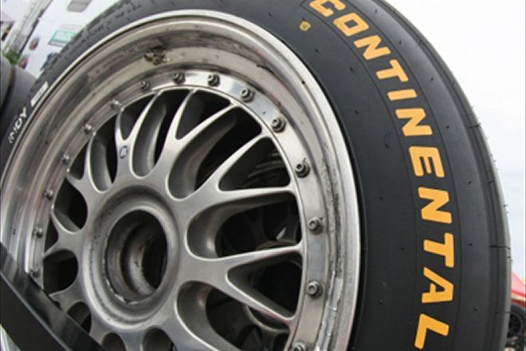
Continental Tire
Hanover, Germany

Slide 3
Global auto & truck parts manufacturer
164,000 employees
46 countries
One of the tires factory in France
1,000 different kinds of tires
1.5 million square feet
Raw material
Sheet of rubber on wheeled carts
Manually tracking if carts are not in expected location
Sometimes lost track of tire components altogether

Slide 4
Missing material
Bottlenecks and production delay
Real-time location system
Wi-Fi & RFID (Radio frequency identification) tag
Inventory tracking system software
Implementation
RFID tags on 1,100 carts
Carts transmit signal to Cisco Wi-Fi network
Mobile-view software pick up the signal
Show the carriers on a map

Slide 6
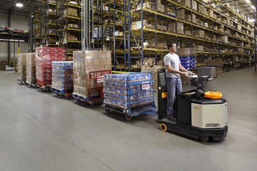
Tuggers
Small trucks for hauling carriers
DLOG
Mobile vehicle-mounted computer
Access MobileView
Pull up a map
See an icon where the carrier is

Slide 7
Material inventory tracking systems
Barcodes attached
Components
Carriers
Associated with RFID info

Slide 8
Productivity increased
When components are needed
Tugger driver use DLOG to
Identify the location of carrier
Scan barcode to
Update material status
Fewer material is thrown away
Expired
Not used when needed

Slide 9
7.1 Telecommunications and Networking
in today’s business world
7.2 Communication networks
7.3 The global Internet
7.4 The wireless revolution

Slide 10
7.1 Telecommunication & Networking in today’s business world
CANT stay in business without networks
Communication with
Employees
Customers
Supply partners
EMS (Electronic Manufacturing Service)
Foxcomm, Flextronic
982, 98% within 2 days
1002, 100% within 2 days

Slide 11
Used to be
Telephone networks: voice communication
Computer networks: data traffic
Today
Single digital network
Internet based standards and equipment
Voice, video, and data communications
More powerful: faster
More portal: smaller and mobile
Less expensive

Slide 12
What is a Computer Network
Two or more computers connected
Client computers
Dedicate server computer
Network interface
Connection medium
Network operating system

Slide 13
Network interface card, NIC
Hardware
Network operating systems
Route and manage communication
Coordinate network resources
Novell, Netware
Microsoft
Linux

Slide 14
Figure 7.1 components of a simple computer network

Slide 15
Networks communication equipments
Hub
Connect network equipment
Switch
Filter and forward data to a specified location
Router
Connect two or more networks
Direct packets to its destination (routing tables)
Same protocol
Gateway
Different protocols

Slide 16
Networks in large companies
Corporate-wide networking infrastructure
Large numbers of LAN
A number of powerful servers
Corporate website
Corporate intranet
Extranet
Back-end systems
ERP
Order entries

Slide 17
Figure 7.2 corporate network infrastructure

Slide 18
Key digital networking technologies
Client/Server computing
Distributed computing model
Processing power
Small, inexpensive client computers
Server
Set the rule of communication
Provide each client with an address
Replaced centralized mainframe computers
Processing on a central large computer

Slide 19
Packet switch
Packet
Method of slicing digital messages into parcels
Route
Different communication path as available
Reassemble
Once arrive destination
封包交換 vs.
analog switch 類比交換

Slide 20
Figure 7.3 packed-switched networks and packet communications

Slide 21
TCP/IP and connectivity
Network
Diverse hardware and software components
Protocol
Common set of rules
Governing transmission of information
Proprietary protocol
Incompatible

Slide 22
TCP/IP
Single, common, worldwide standard
US Department of Defense
TCP, transmission control protocol
The higher level
Disassembling of file into packets and reassembling the packets into the original message
IP, Internet Protocol
The lower level
Handle the address part of each packet

Slide 23
Figure 7.4 the transmission control protocol/internet protocol (TCP/IP) reference model

Slide 24
7.1 Telecommunications and Networking in today’s business world
7.2 Communication networks
7.3 The Internet
7.4 The wireless revolution

Slide 25
7.2 Communication Networks
Signals: digital vs. analog
Analog
Continuous waveform
voice
Digital
Digital, binary waveform
String of two discrete states: zero bits & one bits
Computer

Slide 26
Modem: device to translate digital into analog …
Figure 7.5 functions of the modem

Slide 27
Types of networks
Classify by geographic scope
Local Area network, LAN
Connect PCs and other digital devices within 500 meters
Small office
In one building
Campus area network
Metropolitan area network
Wide area network

Slide 28
LAN
Peer-to-peer architecture
Treat all processors equally
Do not need server to
Exchange data
Share peripheral

Slide 29
7.1 Telecommunications and Networking in today’s business world
7.2 Communication networks
7.3 The Global Internet
7.4 The wireless revolution

Slide 30
7.3 The Global Internet
Indispensable personal and business tool
What is the Internet
The world’s most extensive, public communication network
Client/server computing
Internetworking
Began in the early 1970s
Department of Defense

Slide 31
Internet addressing and architecture
TCP/IP protocol suite
Every computer on the Internet
Unique IP address
32 bit
4 strings of numbers
1 – 255
Separate by DOT
140.117.71.1
IPv4

Slide 32
Message send on the Internet
Decompose into packets
Using the TCP
Packets contain its destination address
Send from client to network
…

Slide 33
DNS, Domain name server
Domain name
English-like names that corresponds to the IP address
www.microsoft.com
Convert IP to domain name
Vice versa
Hierarchical structure
Root domain
Top level domain
second level domain

Slide 34
Figure 7.6 the domain name system

Slide 35
Internet architecture and governance
Backbone
Transcontinental high speed network
Own and operate by
Long distance company
Network service providers
National government

Slide 36
Figure 7.7 internet network architecture

Slide 37
No one “owns” the Internet
No formal management
Worldwide Internet policies
Established by professional organizations and government bodies
The Internet corporation for assigned names and number (ICANN)
assign ip address
The world wide web consortium (W3C)
set standards for HTML

Slide 38
Internet can be censored as traditional broadcast media
The Internet is not “free”
Student, employee do not pay for access
Organization and business pay its own local Internet connection service
Inexpensive
Fast
communication medium

Slide 39
The future Internet: IPv6 and Internet2
IPv4
32 bits addressing
4.5 billion addresses
IPv6
128 bits addressing scheme

Slide 40
Shortcomings of Internet
Poor security
No service level guarantees
No differential service
No differential pricing
Bandwidth limitation
Internet 2
Next generation Internet

Slide 41
Internet Service
Internet based on client/server
Individuals use client software on their computers
Mail, web browse, …
Data store on server
Mail server, website, …
Client platform
PC
Information appliances
Cell phone, PDA

Slide 42
Internet services
E-mail
Chatting and instant messaging
Newsgroups
Telnet
File Transfer Protocol (FTP)
World Wide Web
VoIP
Virtual private network (VPN)

Slide 43
Figure 7.8 Client/server computing on the Internet

Slide 44
Figure 7.9 how voice over IP works

Slide 45
Virtual private network, VPN
Secure, private, dedicate network over the public Internet
Encrypted
PPTP
Point-to-point tunneling protocol
Guaranteed bandwidth
Inexpensive
Compare to private network

Slide 46
Figure 7.10 A VIRTUAL PRIVATE NETWORK USING THE INTERNET

Slide 47
World wide web
The most popular Internet service
The universally accepted standards
Storing
Retrieving
Formatting
Displaying
Information

Slide 48
Web pages
Formatted using hypertext
Embedded links
Connect documents to one another
Link to other objects
graphic
video

Slide 49
Hypertext
Hypertext Markup Language (HTML)
Ex: <b> Bold Face </b>
Formats documents
Incorporate dynamic links
HTTP (hypertext transfer protocol)
Communication standard used to transfer hypertext documents

Slide 50
Universal resource locator (URL)
http://bm.nsysu.edu.tw/tutorial/mis/index.html
網址
Domain name
Directory path
Document name
Document type

Slide 51
Web server
Software
Locating and managing stored web pages
Locates the web pages requested by a user
Deliver the web pages to the user’s computer
Dedicate computers
Apache HTTP server
70%
Microsoft Internet Info Service (IIS)
21%
Website
A collection of web pages linked to a home page

Slide 52
Searching for info on the Web
Surface web
Google visited about 8 billion pages in 2005
Deep web
Estimated 800 billion additional pages
The Wall Street Journal Online
Protected corporate websites

Slide 53
Search engines
Help finding specific web page nearly instantly
Killer application
Hundreds of different search engines
index

Slide 54
Search engine
Start out in early 1990s
Simple software
Roamed the Web
Visiting pages
Gather info about the page
Crawlers, spiders, wanderers

Slide 55
Search methods
Indexing
Simple keyword indexes
Count the number of times a word appear on the pages
Results may be
very long
not truly relevant
Yahoo! 1994
Never a real search engine
Edited selection of websites

Slide 56
Google 1998
Index web pages
Rank search results
Calculate what other sites link to that page
PageRank system, (patented)
Keywords & combinations of words

Slide 57
Figure 7.12 how google works

Slide 58
Search engine marketing
Internet advertising
Two types of results listings
Sponsor links
Advertisers paid to be listed
Precisely match consumer interests
Un-sponsored “organic” listing

Slide 59
Search engine optimization (SEO)
Optimize the webpages
To achieve a higher ranking with major search engine
Ensure keywords used in webpage to match keywords searched
Link your website to as many other websites

Slide 60
Social search
Fewer, more relevant, and trustworthy search results based on a person’s networks of social contact
Google +1
User place a +1 next to website they found helpful
When search
+1 sites will list

Slide 61
Intelligent agent shopping Bots
Intelligent agent software
Searching the Internet for shopping information

Slide 62
Web 2.0
Second generation interactive Internet-based service
Enable user to contribute information
Online photo album
Blog
Wikipedia 維基百科
Social networking

Slide 63
Popular Web 2.0 innovations
Blogs
Weblog
Informal yet structured web sites
Individual can publish stories, opinions, and link to other sites
Personal publishing tool

Slide 64
Popular Web 2.0 innovations
RSS
Rich site summary
Really simple syndication
Pull specific content from web sites
Feed automatically to users’ computers
Install aggregator or news reader software
Web browser’s RSS capability
Business uses RSS to distribute updated corp. info

Slide 65
Popular Web 2.0 innovations
Wiki
User can add, delete, or modify content
wikipedia.org
Online open-source encyclopedia
Business use wiki instead of email to
Create meeting agendas
Post training videos

Slide 66
Web 3.0
Semantic Web
Finding the “meaningful” info
Design computers to analyze and manipulate contents
Paris Hilton
Hilton in Paris
Machine facilitated understanding of information

Slide 67
7.1 Telecommunications and Networking in today’s business world
7.2 Communication networks
7.3 The Internet
7.4 The wireless revolution

Slide 68
7.4 The wireless revolution
Cellular systems
Mobile platform for voice & data
Cellular network standards & generations
Several competing & incompatible standards
GSM
Global system for mobile communication
The rest of world outside of USA
International roaming
CDMA
Code division multiple access
USA

Slide 69
Cellular generations
Voice
Text message
Short message service
3G
Third generation networks
394 kbps ~ 2 Mbps
Video, graphic, …

Slide 70
4G
100 Mbps – 1 Gbps
Pre-4G
Long Term Evolution (LTE)
Mobile WiMax

Slide 71
Wireless computer networks and Internet access
Bluetooth, WiFi, WiMax
Bluetooth
Personal area network (802.15)
Eight devices
10 meters radium
Low power
Radio based
722 kbps
2.4 GHz band

Slide 72
Figure 7.13 a Bluetooth network

Slide 73
WiFi
Local area network
802.11x, x=a, b, g, n
802.11a
10 – 30 meters
802.11b
30 – 50 meters
Operate in two different modes
Infrastructure Mode
Access point: 無線基地台、寬頻分享器
Ad hoc, peer-to-peer

Slide 74
Figure 7.14 an 802.11 wireless LAN

Slide 75
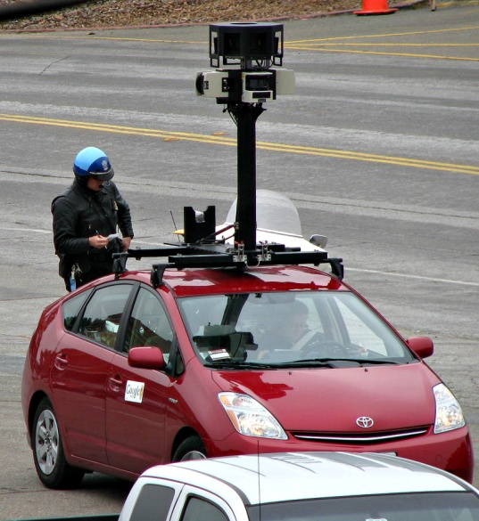
Wi-Fi and wireless Internet access
Hotspot
Access points in public place to provide wireless Internet
Free, starbucks
Fee-based
hotels, airports
Challenges
Can not roam freely
Weak security features
Susceptibility to interference
Many system operate in the same spectrum

Slide 76
WiMax
Metropolitan Area network
802.16
Range up to 31 miles
75 Mbps
Microwave

Slide 77
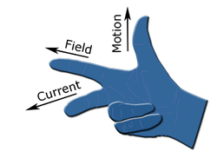
RFID & wireless sensor networks
RFID, radio frequency identification
Tracking the movement of goods
Transponder, tiny tag
Microchips
Data about items and its location
Transmit radio signals over a short distance
Antenna
RFID reader
Fleming's right hand rule
An EPC RFID tag used by Wal-Mart
Wikipedia.com

Slide 78
RFID reader
Antenna and radio transmitter
1 inch to 100 feet
Decoding capability
RFID tag comes within the range of the reader
The tag is activated and begin to send data

Slide 79
7.15 how RFID works

Slide 80
RFID
Low frequency system
Short reading ranges, (inches and a few feet)
Lower system cost
Security system, asset tracking, animal ID
High frequency system
Can extend beyond 90 feet
Automated toll collection

Slide 81
RFID challenges
Cost of tags
19 to 5 cents a piece
Massive amount of data generated
Special middleware
Filter
Aggregate
Prevent RFID data from overloading business network

Slide 82
Figure 7.16 a Wireless sensor network

