Slide 1
Foundations of Business Intelligence: Database & Information Management
accurate, timely and relevant info

Slide 2
春江水暖鴨先知
Google Flu Trend

Slide 3
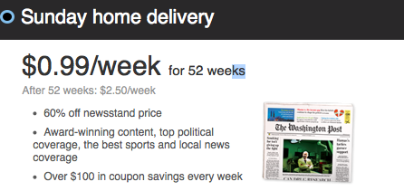
Customers Contact Management
Toronto, Canada

Slide 4
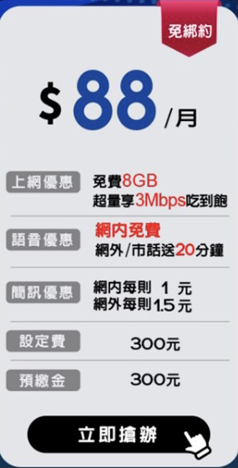
顧客接觸
報章雜誌提供訂購優惠
自己已經訂閱

Slide 5
傳遞不必要的訊息給顧客
惱怒顧客
增加行銷成本
原因
資料管理不當
現有客戶名單
潛在顧客名單

Slide 6
The Globe and Mail
現有顧客 330 萬
外購第三方潛在顧客名單
『拒絕聯絡』名單
分別儲存於大型主機
資料使用者
自行下載
轉換成 Microsoft Access, Foxbase Pro, Microsoft Excel

Slide 7
解決方案
SAP NetWeaver BW
(資料倉儲 data warehouse)
匯集所有資料來源成單一資料庫
使用者自行存取與分析

Slide 8
效益
行銷企劃案
過往：需時 2 週
現在：1 天
消除重複行銷的困惱
改變員工作業習慣
強化教育訓練

Slide 9
Contents
6.1 Traditional file environment
6.2 The database approach to data management
6.3 Using databases to improve business performance and decision making
6.4 Managing data resources

Slide 10
Traditional File Environment
Data hierarchy
Bit
Byte
Word
Field
Record
File
Database: a group of related files

Slide 12
Entity
Information we stored & maintained
Personnel, order, event, …
Record
Attribute
Characteristic or quality describe entity
Name, Social security number, birthday, …
Field
Key field: an field can uniquely identify an record

Slide 13
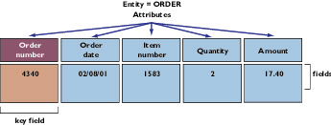

Slide 14
Problems with traditional files
Most organizations grow info system independently to its functions
Each application has its own files and programs
Multiple master files created, maintained

Slide 15
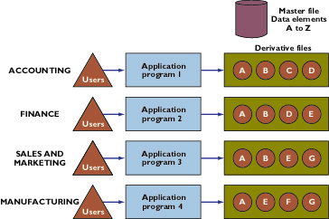

Slide 16
Multiple master files
Created
Maintained
Operated
by separate divisions or departments
Years later, no one knows
What data they use
Who is using those data

Slide 17
Problems with traditional files
Data redundancy and confusion
Program-data dependency
Lack of flexibility
Poor security
Lack of data sharing and availability

Slide 18
Data redundancy and inconsistency
Different divisions collect the same data
Customers
Sales
Account receivable
Service
Data inconsistency
Different coding to represent the same value
XL, extra large, extra-large

Slide 19
Program-Data dependency
Coupling of stored data and programs which update and maintain those data
Traditional program need to specify location and nature of data
綠野遊蹤
Changes in data require
updates on all the programs which access that data

Slide 20
Lack of Flexibility
Traditional systems deliver routine scheduled reports 海關有油品進口資訊
Can NOT deliver ad hoc reports 黑心油事件
Can not respond to unanticipated information requirement 油品流向分析
In a timely manner

Slide 21
Poor Security
Without knowing who is accessing or even making changes to data
Lack of data sharing and availability
Information is virtually impossible to flow freely across different function areas
Hard to related data from different systems

Slide 22
Contents
6.1 Traditional file environment
6.2 The database approach to data management
6.3 Using databases to improve business performance and decision making
6.4 Managing data resources

Slide 23
The Database Approach
Database
Centralized collection of data
Minimize redundant data
Shared by all users (Departments)
Serve many applications efficiently
Information flows between functional areas
Data does NOT flow, Centralized instead

Slide 24
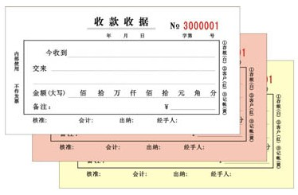
Information flow as Data flow
sales
Sales info systems
Customer
orders
accounting
Accounting info systems
production
Production info systems

Slide 26
Information flow with Data CENTRALIZED
Production
Customers
WEB
Order master (file)
Sales
ERP

Slide 27
Database Management Systems (DBMS)
Software
manage data efficiently, and provide access to the stored data by application programs
Interface
between application programs and physical data files
Programs calls for data
DBMS handles the access of data
No need to specify size and format of data

Slide 28
Logical and physical view of the data
Logical view
Presents data as they would be perceived by end users or business specialists
Human Resources database
Benefit view, payroll view

Slide 29
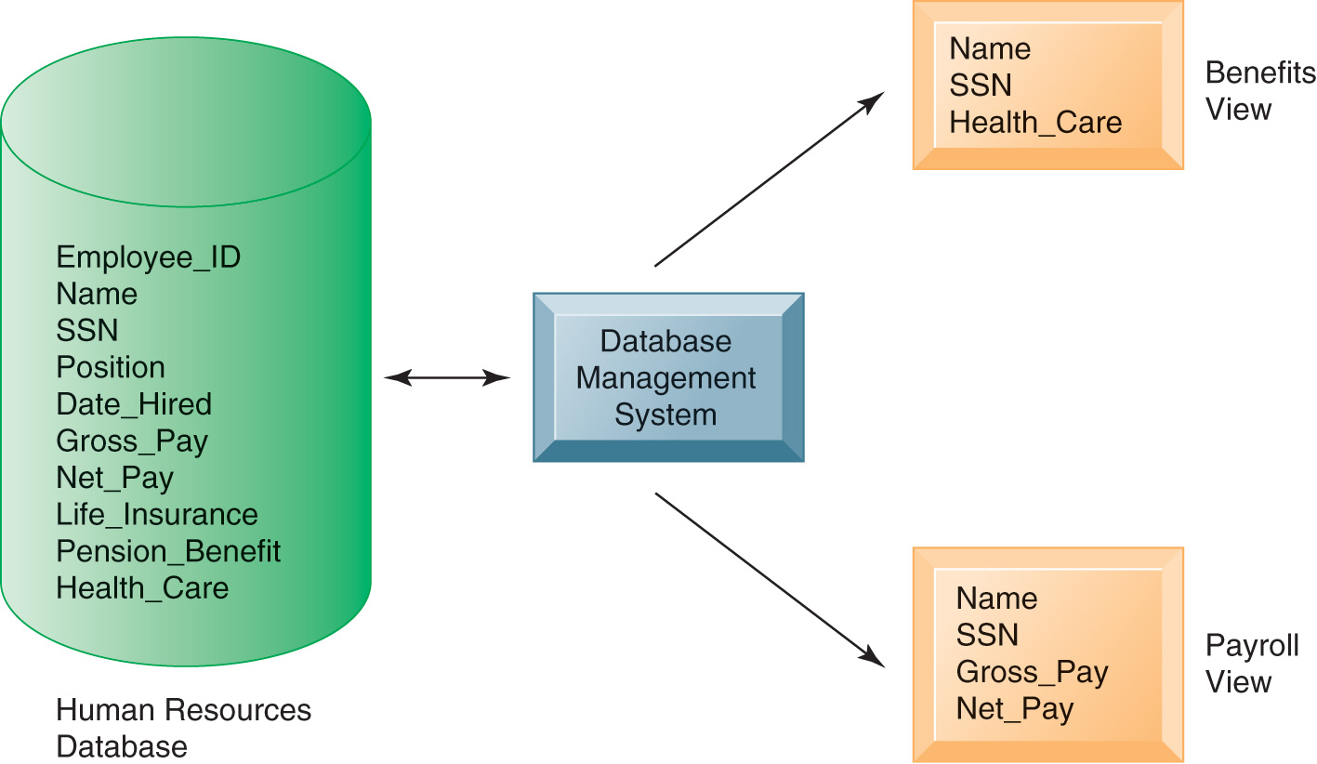

Slide 30
Physical view
How data are actually organized and structured on physical storage media

Slide 31
Relational DBMS
Most popular DBMS
Represent data as two dimensional tables (Relations)
Tables similar to flat files
Rows are unique records (Tuples)
Columns are fields (Attributes)
Tables are related by sharing a common data element

Slide 33
Leading relational DBMS
Mainframe
DB2
Oracle
Midrange
DB2
Oracle
SQL Server
PC
Access
Oracle lite
MySQL

Slide 34
Operations of a relational DBMS
Select
Creates a subset of rows
All records that meet stated criteria
Join
Combines relational tables
Provide more information than is available in individual tables

Slide 35
Project
Creates a subset consisting of columns
To create new tables
Contains only the information (attributes) required

Slide 37
Non-Relational Databases & database in the cloud
Conventional database handles homogeneous data
Structured numbers and characters
Predefined data field and records
Organized in rows and tables
web, social media, photo, voice, video
“NoSQL” non-Relational database
Manage large dataset
Across many distributed machines

Slide 39
Database in the cloud
Lower cost
Less functionality
Amazon Web service
SimpleDB
Relational database service
MySQL open source
Amanzon RDS
Full capabilities of MySQL
Microsoft SQL Azure Database
Cloud-based
Oracle NoSQL database
Public cloud

Slide 40
Private cloud
Sabre Holding
World largest software as a service (SaaS)
Aviation industry
Install a private cloud
Pool of standardized servers
Running Oracle database 11g
Supports 100 projects and 700 users

Slide 41
Capabilities of DBMS
Data definition language
Specify the structure of content of the database
Data manipulation language
To manipulate data in the database
In conjunction with 3rd or 4th generation programming language
Data dictionary

Slide 42
Data definition language
Formal language
SQL: structured query language
Specify content and structure of the database
Defines each data elements
Can be embedded in application programming
CREATE TABLE employee (
id INT PRIMARY KEY,
firstname CHAR(30) NOT NULL,
lastname CHAR(30) NOT NULL);

Slide 43
Data manipulation language
Manipulate data in the database
Permit end user and programmer to extract data to satisfy information requests and develop applications
SELECT partNumber, partDescription
FROM part
WHERE unitPrice <= 25.00;

Slide 44
Data dictionary stores definitions of
Data elements &
Data characteristics
Physical representation, ownership, authorization, and security

Slide 45
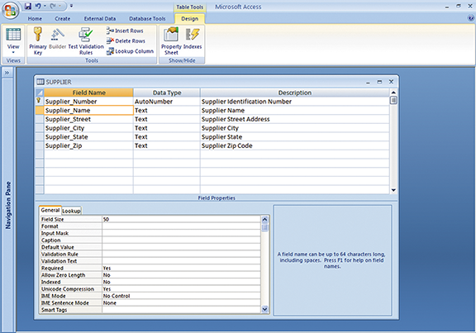
Data dictionary

Slide 46
Querying & Reporting: SQL
Interactive query language for relational DBMS to access data from database
Querying, reading, updating
Select data-elements
From tables
Where conditions

Slide 47
SELECT Part_Number, Part_Description
FROM part;

Slide 48
SELECT Part_Number, Part_Description
FROM part
WHERE Unit_Price < 25.00;

Slide 49
SELECT COUNT(DISTINCT AUTO.CUSTNUMB) FROM
(AUTO, HOME, CUSTOMER) WHERE
AUTO.CUSTNUMB = HOME.CUSTNUMB AND
AUTO.CUSTNUMB = CUSTOMER.CUSTNUMB AND
CUSTOMER.STATE = ‘NY’;

Slide 50
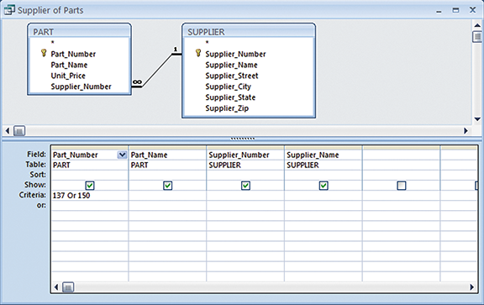
Query

Slide 51
Designing databases
Conceptual or Logical design
Abstract model from business perspective
Detail description of the business information need of the actual end users
How the data elements to be grouped
Physical design
How the database is actually arranged on direct access storage devices

Slide 52
Normalization
Minimize redundant data elements and awkward many-to-many relationship
A relation contains repeating groups
Same data repeats many times
The real reason is
A relation contains more than one entity
Repeating data group
Fig (not in the textbook)

Slide 53
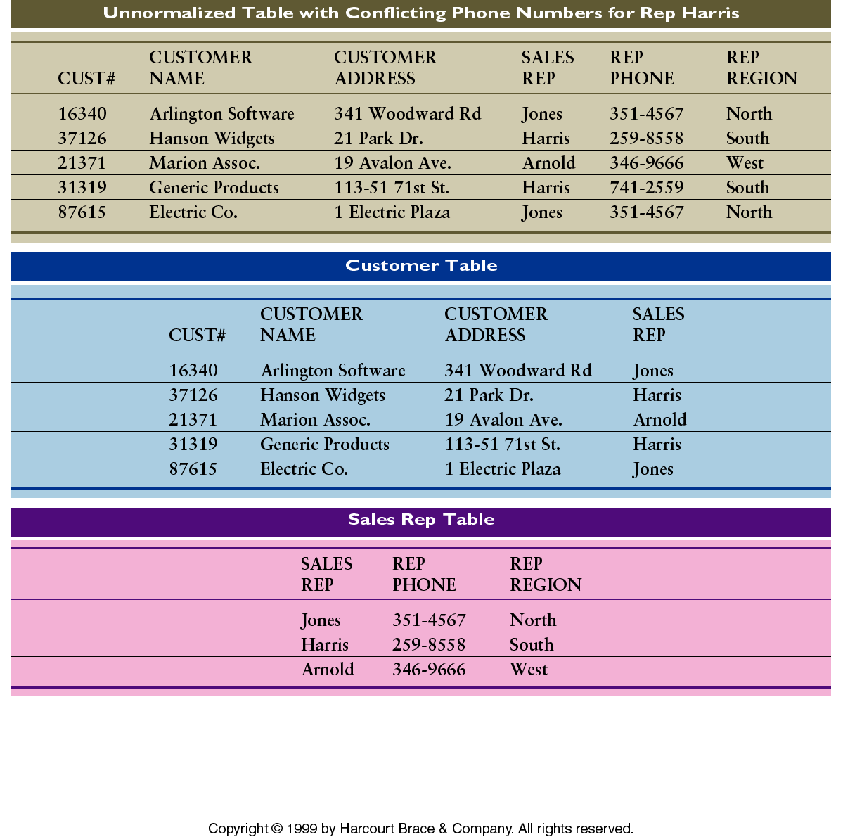

Slide 54
Referential integrity:
rules to ensure that relationships between coupled tables
remain consistent

Slide 55
Entity Relationship Diagram
Tool to document the data model
1-to-1
1-to-many

Slide 56
Contents
6.1 Traditional file environment
6.2 The database approach to data management
6.3 Using databases to improve business performance and decision making
6.4 Managing data resources

Slide 57
Transaction data
Fit into rows and columns (relational database)
Structured data
Big data
Web traffic, email messages, social media content, machine-generated data
Semi-structured, unstructured
Tweeter generates over 8 terebytes of data daily

Slide 58
Business Intelligence infrastructure
Data Warehousing & Data Marts
Business decision making need
High level analysis of patterns and trends
integrated key operational data from around the company
Data often fragmented in separate operational systems (sales, payroll, ….)
consistent, reliable, and easily available

Slide 59
Data Warehouse
Store current and historical data
potential interest to managers
Data originates
Legacy system, DBMS, Web sites,… (Fig 6-13)
Data are standardized into a common data model and consolidated
Data are available for anyone to access, but can NOT be altered.

Slide 60
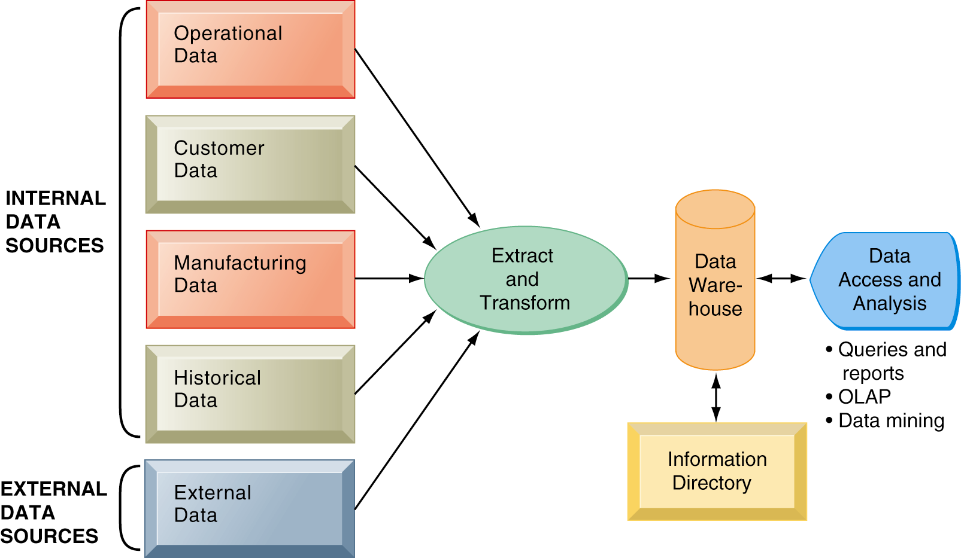
TEJ
臺灣經濟新報資料庫

Slide 61
Data Mart
Summarized or highly focused portion of the organization’s data
Smaller, decentralized warehouse
Constructed more rapidly and at a lower cost
Too many data marts increase
the complexity, costs, and management problems

Slide 63
In-memory computing
Relies primarily on a computer’s main memory (RAM) for data storage
Traditionally use disk storage system
Complex business calculation
Used to take hours or days
Complete within seconds
SAP’s high-performance analytics appliance (HANA)

Slide 64
Analytic platforms
Preconfigurated hardware-software system
Specially designed for query processing & analytics
10 – 100 times faster than traditional systems
IBM Netezza, Oracle Exadata

Slide 66
Analytical tools:
Multidimensional data analysis, and Data mining
Consolidating, analyzing, & providing to access vast amount of data
Analyze data for new patterns, relationships, and insights to guide decisions
Help users make better business decisions

Slide 67
On-Line analytical processing (OLAP)
Managers need to analyze data in multidimensional view
Enable the users to view the same data in different ways
By product, pricing, cost, regions, or time period

Slide 68
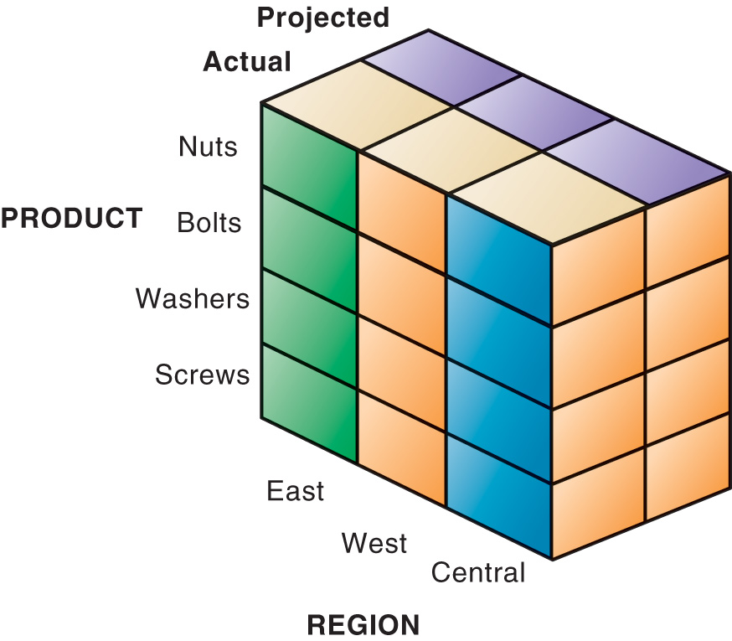

Slide 69
Data mining
Find hidden patterns and relationships in large pools of data
Infer rules, patterns and relationships
predict future behaviors and guide decision making
Information obtained
Associations
Occurrences linked to a single event
When corn chips are purchased, a cola drink is purchased 65% of the time
Sequence
Events are linked over time
A house is purchased, a refrigerator ….

Slide 70
Classification
Recognize patterns that describe the group by examining the existing rules
Telecom: customers who are likely to leave
Cluster
Similar to classification
When no groups have yet been defined
e.g. affinity groups for bank card
via demographics, personal investments

Slide 71
Text mining & Web mining
Unstructured data
Text files
Emails
Memos
Call center scripts
Text mining
Tools to extract key info from unstructured data

Slide 72
Web mining
The discovery & analysis of useful patterns and information from the world wide web
Google Trends
Google Insights
Content mining
Extract knowledge from the contents
Structure mining
Examine data related to the structure
links points to a document
links coming out of a document

Slide 73
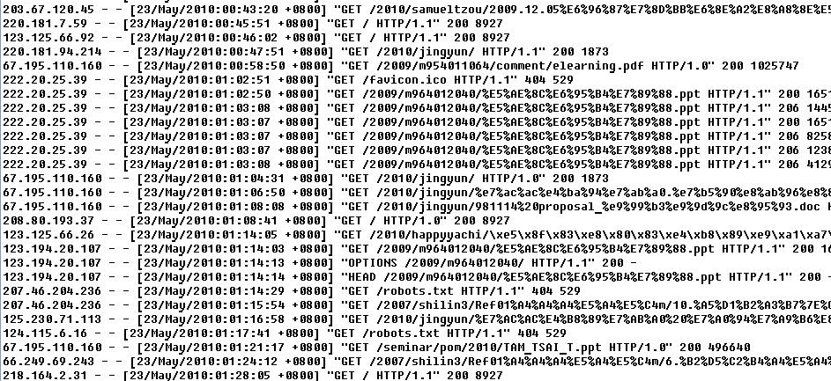
Usage mining
user interaction data
i.e. server’s log

Slide 74
Database and The Web
Making information resources available on the World Wide Web
Web browser is easy to use
Require less training
Cost less to add Web interface for legacy system than to redesign and rebuild to improve user access

Slide 75
Linking internal database to the Web
Application Server
CGI: Common Gateway Interface
Interface between Web Server and application programs
C, PERL, Java, Visual Basic

Slide 76
Contents
6.1 Traditional file environment
6.2 The database approach to data management
6.3 Using databases to improve business performance and decision making
6.4 Managing data resources

Slide 77
Managing Data Resources
Data are an important resource
Need special policies and procedures for effective data management
e.g. who can view sensitive employee data
only payroll & human resources dept’s employee

Slide 78
Information policy:
specify its rules for sharing, disseminating, acquiring, standardizing, classifying, and inventorying information throughout organization
Data administration
Developing information policies
Overseeing logical database design
Monitoring system specialists and end users’ behaviors

Slide 79
Data governance
Policies and processes
Availability, usability, integrity, and security of data
Promoting privacy, compliance with government regulations
Database administration
Establish the physical database, the logical relations among elements, and the access rules and procedures

Slide 80
Ensuring data quality
Database performance depends on
Good database design and data model
Data quality
Faulty data will lead to incorrect decisions
Major obstacle to successful implementation
Enterprise-wide data standard
Data should be named and defined consistently for all business area

Slide 81
Data quality problems
Misspelled names
Transposed numbers
Incorrect or missing codes
Inputs errors
Customers update internal data through website

Slide 82
Data quality audit
Structured survey of the accuracy and level of completeness of data
Data cleansing
Activities for detecting and correcting data
Incomplete
Incorrect
Improperly formatted
Redundant

Slide 83
Interactive session
(Minicase)
Technology
Driving ARI fleet management with real-time analytics
P. 265
Management
America water keep data flowing
P. 275

